Slide 1
PTA Hardfacing
Arcraft Plasma
India

Slide 2
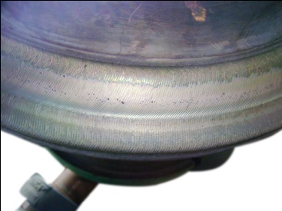
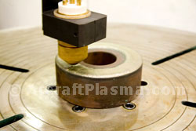
PTA Hardfacing
The Plasma Transferred Arc Process ( PTA ) has been in use since 1962 for surfacing of parts .
The applications possible with PTA are hardfacing to protect against extreme conditions in service life like heat , abrasion , corrosion , erosion ,adhesive and abrasive wear etc.
It is also use to recondition worn out parts or build up of mis machined parts.

Slide 3
PLASMA
Plasma is a state of matter resulting from the inonisation of gas. It is composed of positive ions and free negative electrons. Its ionized condition enables it to conduct current.
Transformation of gas into plasma requires energy and the ionization level increases according to temperature ranging from 6000 to 20000 degrees centigrade. Since the pressure approximates to that of the atmosphere the impact of the fast moving particles on one another are numerous enough for the transformation of their kinetic energy into heat to result in a considerable rise in temperature.

Slide 4
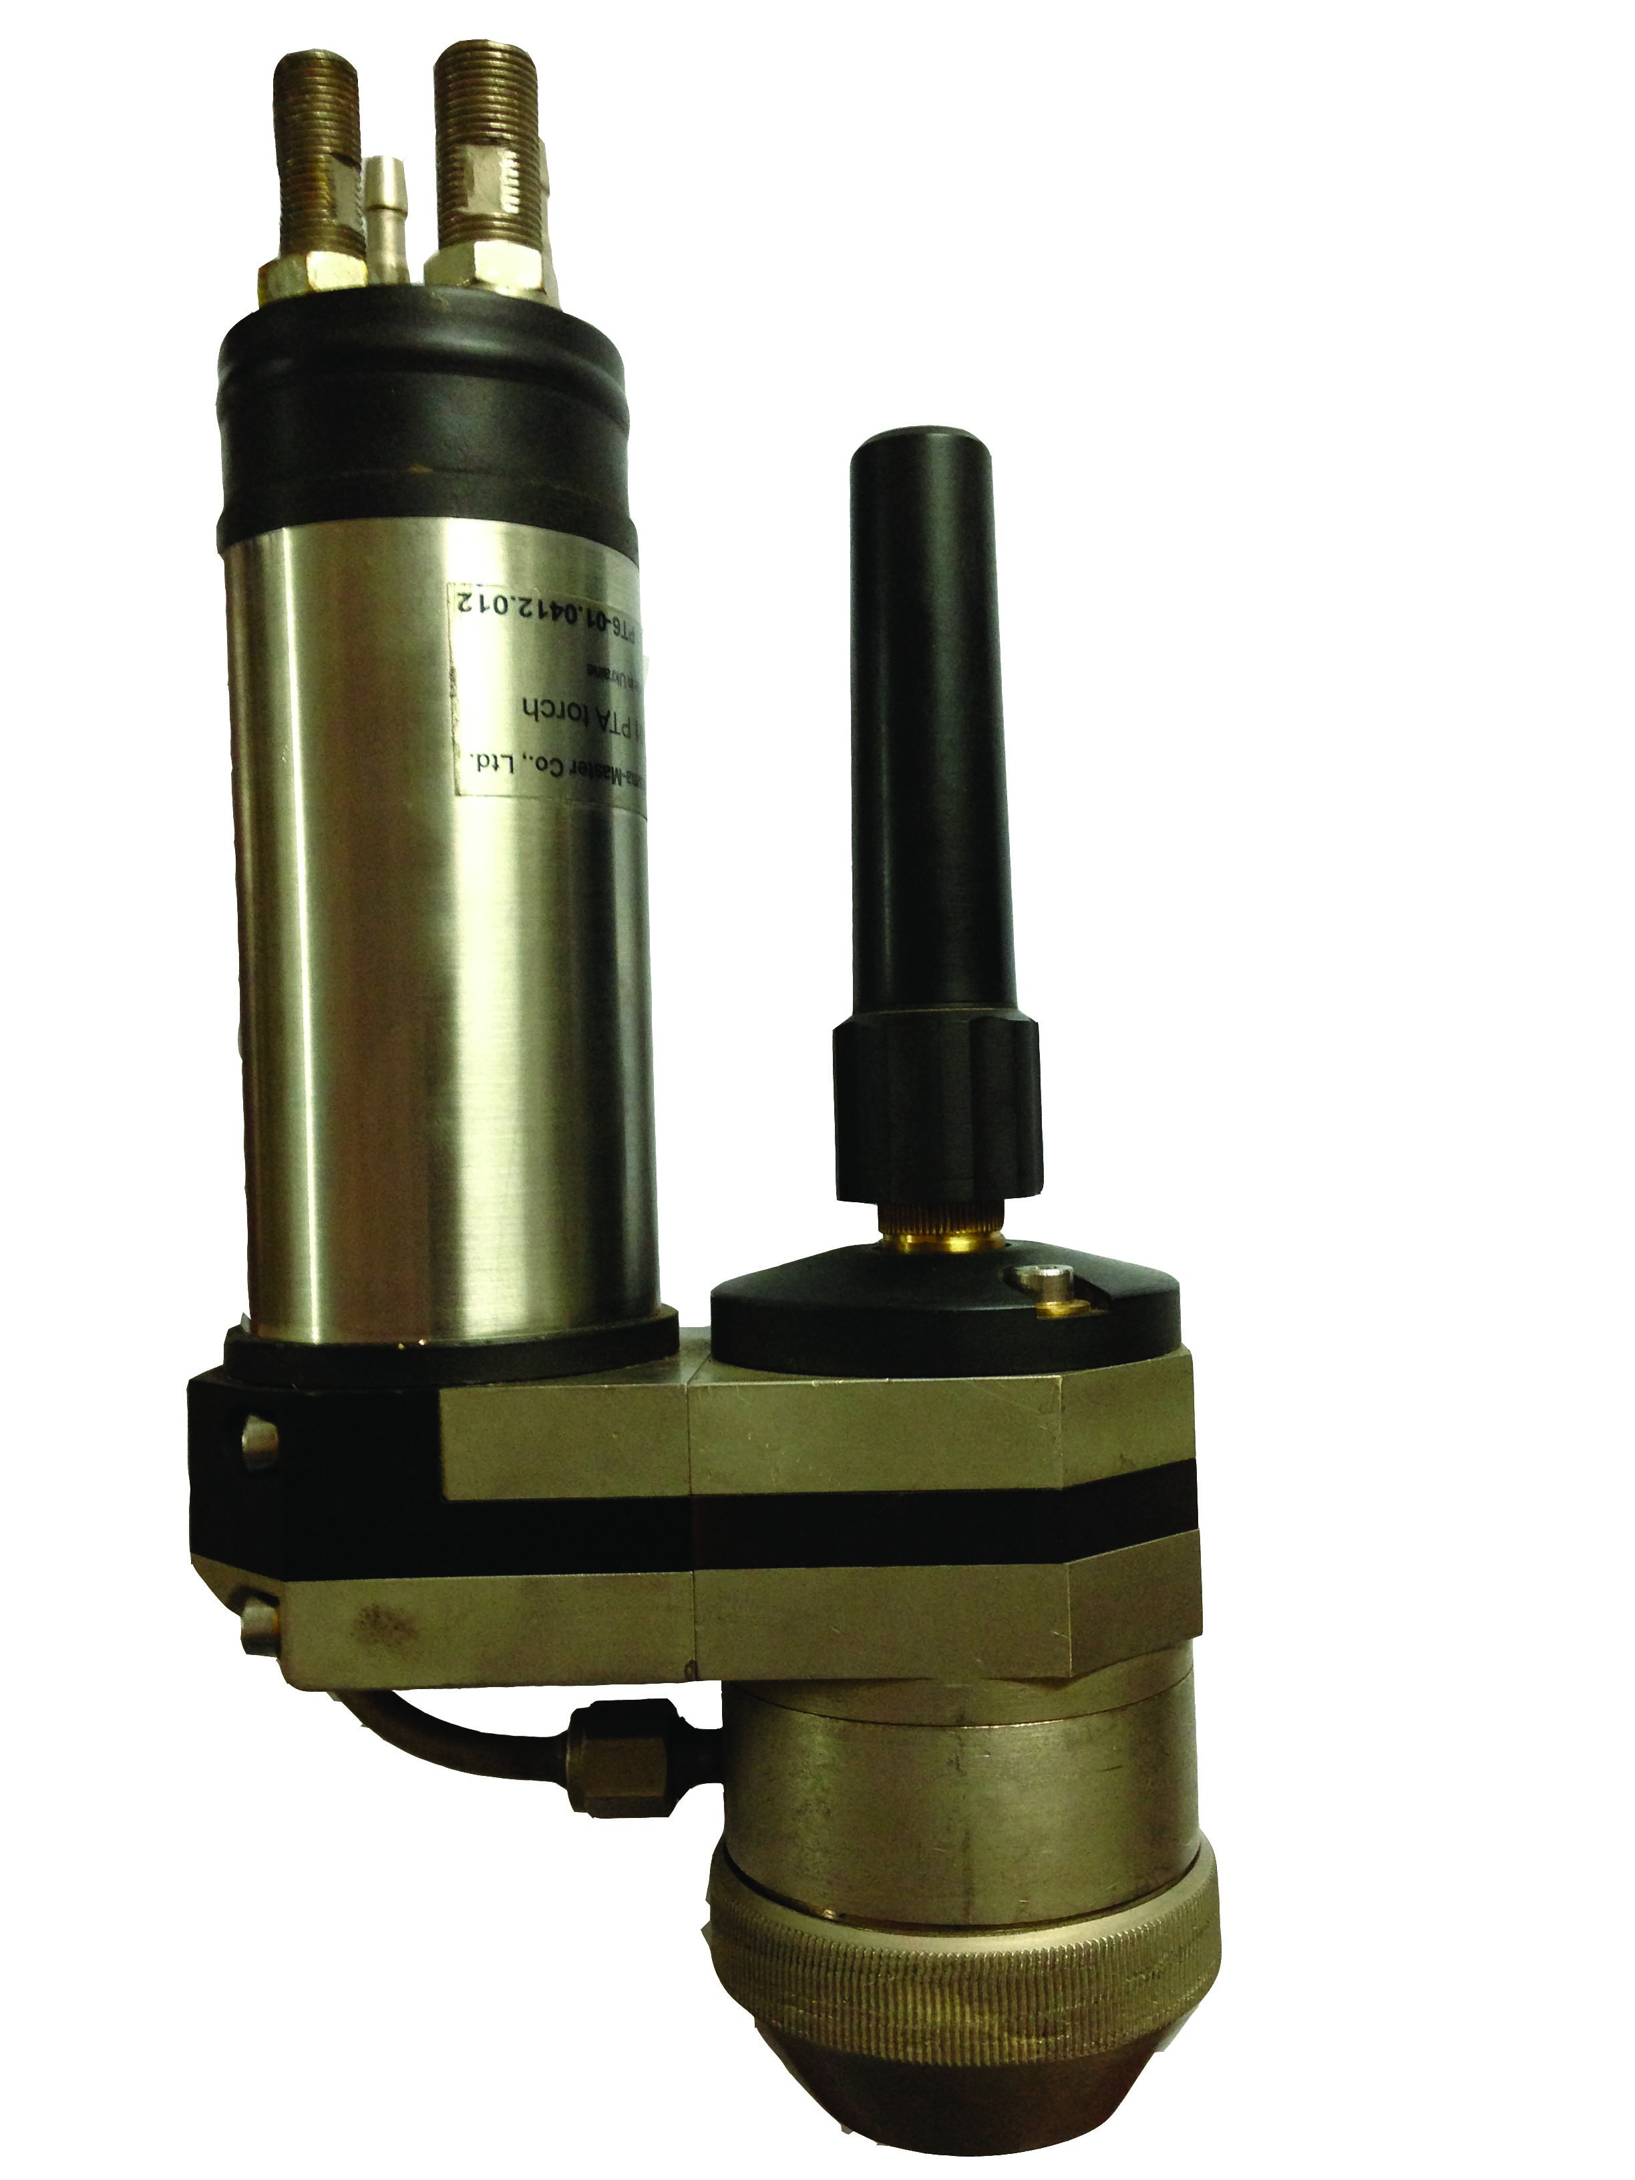
Plasma Torch
The arc is struck between the Tungsten electrode (Cathode) and the job which is the anode . The fine bore copper nozzle constricts the arc into a fine beam as compared to the open arc of TIG welding.
Powder is fed by a powder feeder into the plasma arc through specially drilled holes in the copper nozzle .
Torches using external wire feed are also available . It is possible to use both powder and wire feed combination if extra ordinary high deposit rates are required.

Slide 5
Process
Although many consider Plasma Transferred Arc System (PTA) as a Thermal spray process it is a high energy, inert gas welding process rather than a spraying process. PTA deposition is also called PTAW surfacing because the American Welding Society classifies the PTA deposition under Plasma Welding category .
Argon is basically used for arc plasma supply, powder transport and molten material shielding. The coating material is fed into the Plasma arc in either powder or wire form. The plasma torch has to be held at a distance of 3 to 8 mm from the workpiece mostly in 1 G position.
PTA results in a metallurgical bond with a bond strength of 65000 psi while a average NTA ( Non Transferred Arc ) deposit would feature about 6500 psi . This is because PTA deposits are welded on the substrate.
PTA is suitable for manual, semi or fully automatic operations using manipulators, positioners , oscillators and micro processor controls . It can be used with Robots and adapted with CNC systems. It produces a very high quality deposit offering optimal protection with minimal dilution or deformation of the base material which are relatively low cost surfaces in the case of Hardfacing .

Slide 6
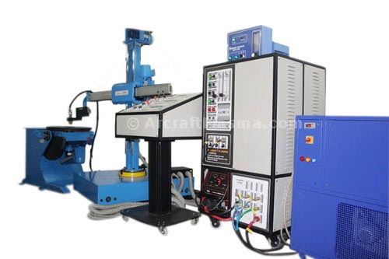
Types of Systems Available
Automated PTA systems
The Main power source itself consist of two power sources for the pilot arc and main transferred arc , Arc starting system , Gas Flowmeters for plasma and shielding gas , Plumbing board for torch connections , Switches and failure indicators .

Slide 7
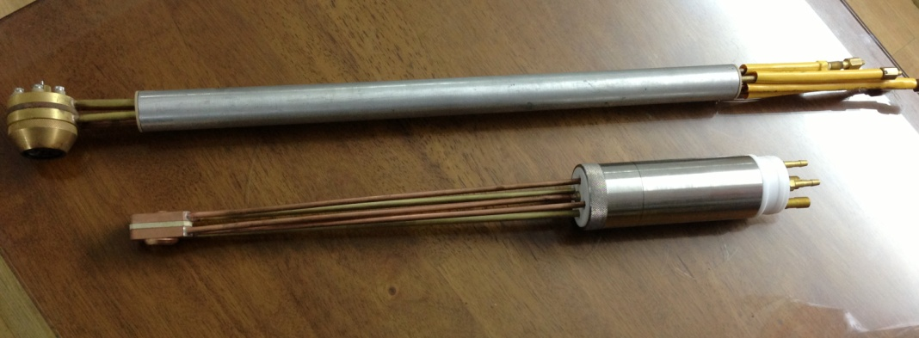
PTA with powder welding for internal diameters
PTA can deposit a coating on an internal or external surface of a cylinder. Internal diameters as small as 2″ (45mm plus) can be hardfaced with no upper limit .
The max current capacity is 200 Amps DC for the ID torch .

Slide 8
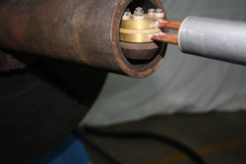
ID hardfacing with PTA

Slide 9
Manual or Automated Applications
Manual Plasma torches are available upto 150 Amps DC . Manual plasma torches and portable power sources are ideal for repair shops and site applications .
Arcraft designs and manufactures SPM as per the jobs and customer requirements.
The designs can be semi automatic or fully automatic.
We use PLC , micro processor or CNC technology for control of the system.

Slide 10
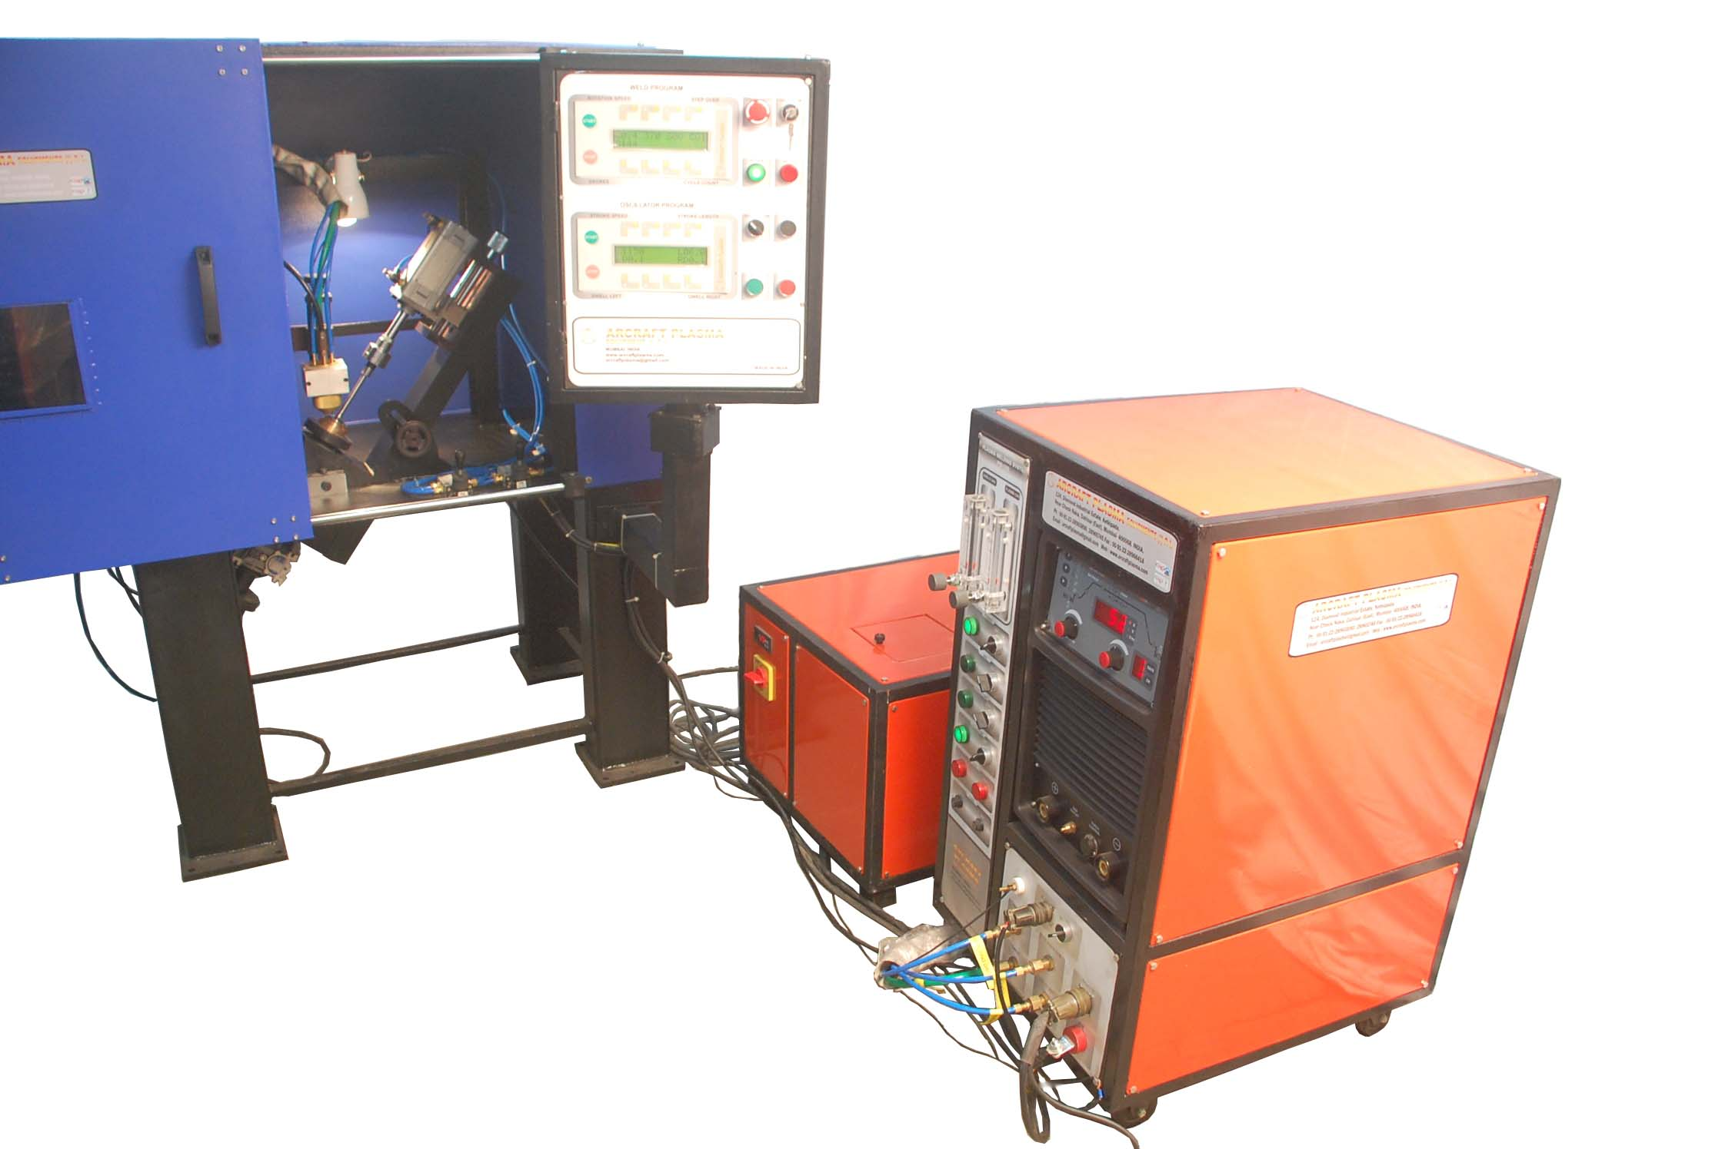
SPM for engine valves

Slide 11
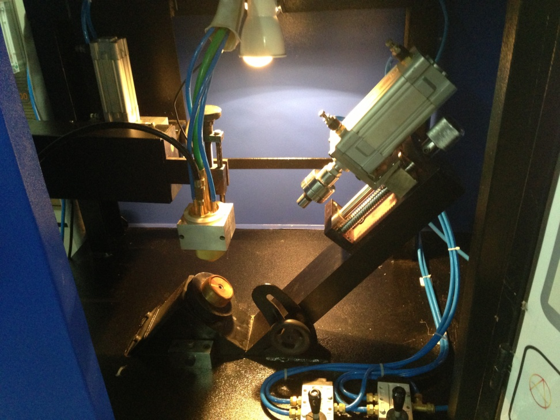
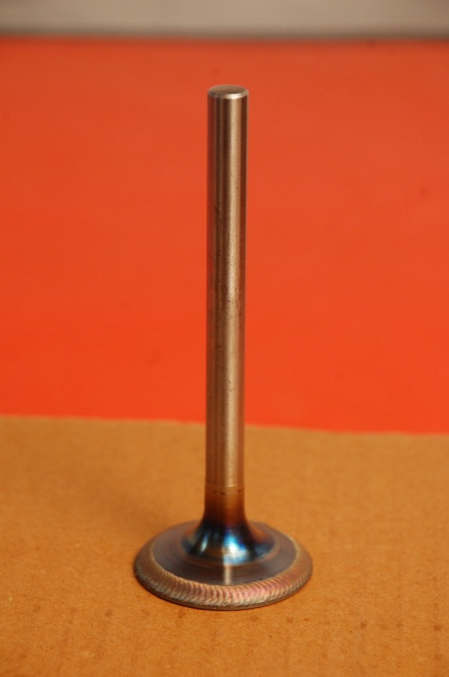
Hardfacing with SPM

Slide 12
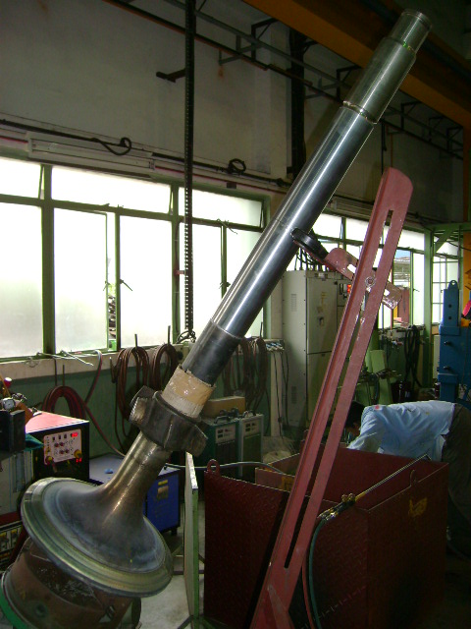
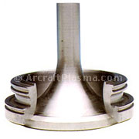
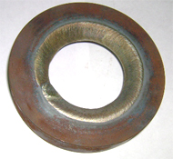
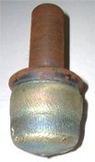
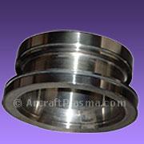
Plug valve / Ship Engine valve /mechanical seals

Slide 13
Advantages of P.T.A.
An attractive controlled weld bead reducing cost / wastage of consumables with little or no ripple reducing time and cost of post weld machining .
Very low dilution with the base metal .
High, density bead without porosity , oxidation & inclusions..
Highly automated
High powder utilisation
Very wide range of hardfacing materials

Slide 14
Versatility in applications
Wide range of deposits: The PTA- applied deposits can be as thin as only 0.5 mm or as thick as 50 or 60 mm. In fact there is no ‘upper’ limit since the thickness may easily be built up to any desired level by repetition i.e. use of ‘multiple passes’.
Wide range of materials: The substrate to be coated may be any industrial metal or alloy. Even difficult materials HCHC alloys, die steels, hot-die steels, HSS etc can be easily coated with a wide variety of materials.
Wide range of coating materials: The coating materials may be elemental metals from aluminium upto zirconium (only solids), or their alloys , cermets e.g. nickel-aluminide, tungsten carbide mixed with ferrous or non ferrous metal powder. A wide range of proprietory overlay alloys are available for practically any part. Some alloys are very hard; others are softer with hard abrasion-resistant particles dispersed in a matrix. Certain alloys are made to rebuild a part to a required dimension while others are designed to be a final overlay that protects the work surface. Soft alloys, medium and high hardness materials, and carbide composites can be deposited on a variety of substrates to achieve diverse properties such as mechanical strength, wear and corrosion resistance, and creep
Narrow range of parameters: As compared to the more famous and established NTA (non transfer arc) option the PTA variation offers a smaller number of parameters to be controlled. The main parameters are arc current, arc voltage (indirectly controlled by arc length), plasma gas flow , shield gas flow , carrier gas flow rate and welding speed. Controlling these requires no special skills and an average welder can confidently yield good deposits. In automated welding the parameters of speed of job movement and speed of oscillation of torch are added.
Adaptability: The PTA option is basically simpler, and hence easy to be adapted for semi-or –fully automatic manipulators or programmable electronic or computerized devices.
Heavy deposition: It is possible to increase the high deposition rates of the PTA deposition even further than 10 kgs/Hr. For instance wire feeders can be used in conjunction with the powder feeder, stepping up the deposition rate from as little as one kilogram/ minute upto several Kgs/mm.

Slide 15
Areas of Applications
The PTA deposition or Surfacing process is one of the most versatile and useful techniques used for what are generally referred as surfacing or overlaying processes.
Following are a few applications to which PTA Deposition has been applied successfully on an international scale .
Hardfacing: Most of the industrial components in an enormous range of wear applications benefit from application of a hand overlay. A variety of nickel-base alloys are available for specific hardness, or a number of other properties combined.
Salvaging/Reclamation: An amazing bulk of all types of industrial components made from simple or complex alloys (e.g. nickel-chromium alloys) are now being dumped as scrap. PTA deposition offers reliable method for salvaging and reclamation .
Application of Special Materials: Sometimes it is a must to apply an overlay deposit of special materials e.g. molybdenum or tungsten etc for lending resistance to elevated temperatures (these are ‘refractory’ materials).. or in the case of industrial valves Stellite equivalent for impact resistance .
Minute Repairs: There are sometimes defects in parts made from difficult-to-weld-materials which cause them to be scrapped. The PTA deposition process can easily build up the missing portion. Such defects are cracks, notches, dents, cavities, deep scratches or scoring marks etc.

Slide 16
Thank you ! Do contact with your requirements .
Arcraft Plasma Equipments ( I ) Pvt Ltd
124 Diamond Industrial Estate ,
Ketkipada , Dahisar ( East )
Mumbai 400068 ,
India .
Phone - 00 91 22 - 28963247 , 28965890 , 28965745
Fax - 00 91 22 - 28966418
Sales Handphone - 00 91 - 9820684001
email : arcraftplasma@gmail.com
web : www.arcraftplasma.com

